Slide 1

Hospital Management System (HMS)
A comprehensive digital platform streamlining hospital operations, automating key processes and improving patient care, efficiency, and resource optimization.

Slide 2
Patient Management
Electronic Medical Records
Patient Profiles
Appointment Tracking
Detailed records of each patient's personal, contact, and insurance information for easy access and management.
Seamless scheduling and monitoring of patient appointments, with automated reminders and notifications.
Centralized digital storage of patient information, including medical history, test results, and treatment plans.

Slide 3

Appointment Scheduling
1
Online Booking
Patients can easily book, reschedule, or cancel appointments through a user-friendly online portal.
2
Calendar Management
Doctors and staff can manage their schedules, view availability, and allocate time slots efficiently.

Slide 4

Prescription Management
Electronic Prescriptions
Medication Tracking
Doctors can easily create and send digital prescriptions to pharmacies, reducing errors and improving efficiency.
Patients can view and manage their prescribed medications, refill requests, and dosage schedules.
Drug Interactions
The system alerts healthcare providers to potential drug interactions or allergies to ensure patient safety.

Slide 5

Billing and Invoicing
Automated Invoicing
Generate and send accurate invoices and insurance claims quickly, using customizable templates.

Slide 6
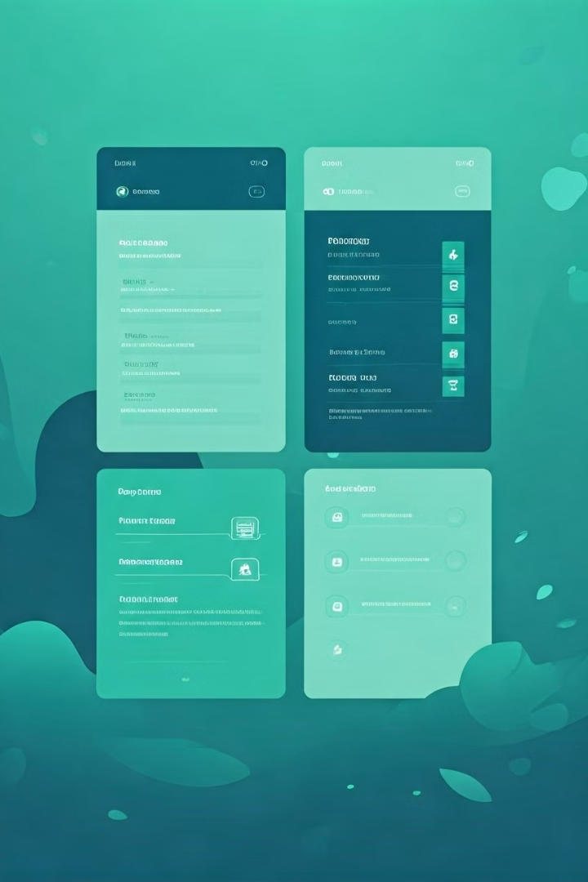
Scalability and Customization
1
Scalable Infrastructure
2
Modular Architecture
The HMS platform is designed to accommodate the growth of healthcare organizations, handling increasing patient volumes and data storage needs.
Our modular design, based on a three-tier structure, makes it easy to add new features and functionalities. This allows healthcare organizations to tailor the platform to their specific requirements.

Slide 7

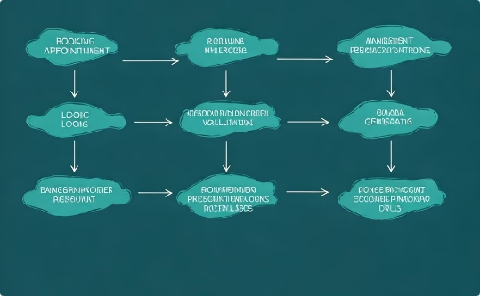
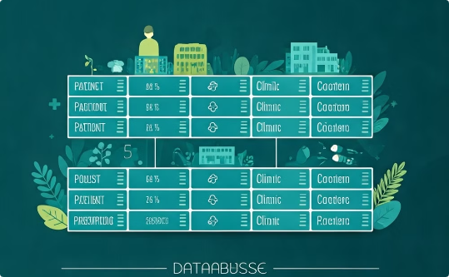
The three-tier for this project
Presentation Tier
Business Logic Tier
Data Access Tier
This user interface layer allows users (Admin, Doctor, Nurse, Patient, Pharmacist) to interact with the system, handling display and user inputs.
This middle layer processes requests from the Presentation Tier, applying core logic.
This layer interacts with the database, performing CRUD operations and managing data storage for patients, doctors, clinics, and prescriptions.
Each layer is separated for scalability, maintenance, and improved performance.

Slide 8






User Roles
Admin
Doctor
Nurse
Manages users, system settings, and access controls.
Manages patient records, schedules appointments, and prescribes medications.
Assists doctors and maintains patient records.
Patient
Pharmacist
Receptionist
Books appointments, views prescriptions, and manages billing.
Reviews prescriptions and assigns medications.
Manages front-desk operations, including patient check-ins and appointment scheduling.

Slide 9
Appointment Workflow
Patient Booking
1
Patients select a clinic, doctor, and available time slot through the platform.
2
Invoice Generation
The system generates an invoice based on the doctor’s visit and prescribed medications.
Appointment Confirmation
3
The receptionist verifies and confirms the appointment and collects payment from the patient.
4
Doctor Consultation
The doctor reviews the patient’s records and prescribes treatments.
Record Maintenance
5
Nurses assist in maintaining updated records.
6
Prescription
Doctors prescribe treatment items.
Medication Assignment
7
The pharmacist reviews the prescription and assigns medications.

Slide 10

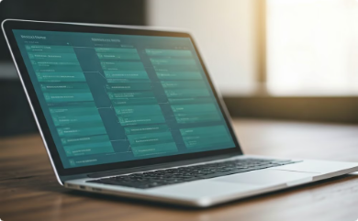


Technology Stack
Backend
Database
Frontend
Security
ASP.NET MVC
Entity Framework (EF Core) with SQL Server
JavaScript, jQuery, Bootstrap
Role-Based Access Control (RBAC), encryption

Slide 11



Challenges & Solutions
Data Inconsistency
Security
User Adoption
Solution: Validation during data entry.
Solution: RBAC & encryption.
Solution: User feedback & training sessions.

Slide 12


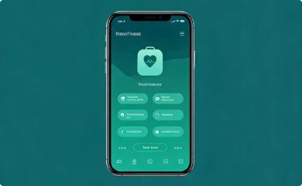

Future Enhancements
Telemedicine Integration
AI-Powered Predictive Care
Mobile App Development
Data Analytics for Insights
Enable remote consultations and patient monitoring, enhancing access to care.
Utilize AI to analyze patient data and proactively identify potential health risks, allowing for early intervention.
Develop a user-friendly mobile app, providing convenient access to healthcare services.
Leverage data analytics to gain valuable insights into patient health and optimize healthcare operations.

Slide 13

We welcome your questions and feedback.
We are happy to address any further inquiries you may have. Your feedback is crucial to our ongoing efforts to improve our services.

Slide 14

Thank you!
We appreciate your engagement and interest in our presentation. We hope it has provided valuable insights and information about our Hospital Management System.

